Slide 1
CI/CD - Continuous Integration / Continuous Delivery Kako to isporučujemo softver? Ratomir Vukadin
ICBL – Banja Luka UG
05-10-2017

Slide 2

C:\WINDOWS\system32> whoami
Ratomir Vukadin
Software Engineer
Diplomirani inženjer elektrotehnike – ES
Lanaco doo
https://www.linkedin.com/in/ratomir-vukadin-rvs/
https://github.com/Ratomir?tab=repositories

Slide 3
Agenda
Razjašnjenje pojmova
Šta je to Visual studio Team Service i TFS?
Impelmentacija CI/CD
Demo

Slide 4
Pojmovi
Continuous integration (CI) means that whenever a developer checks in code to the source repository, a build is automatically triggered.
Continuous delivery (CD) takes this one step further: after a build and automated unit tests are successful, you automatically deploy the application to an environment where you can do more in-depth testing.

Slide 5
Pojmovi
Source control Git – TFVS
Commit/Push – Checkin/Get latest version
Repository – Project
Decentralizovan-Centralizovan

Slide 6
Pojmovi
GIT
TFS
Commit
Push
Sync
Fetch
Repository
Branch
Checkin
Getlatest
Project
Branch

Slide 7
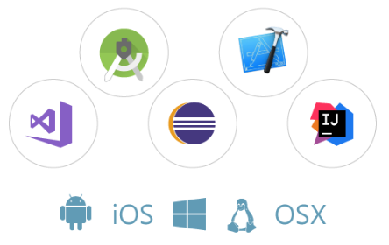
Visual studio team service
Create the perfect dev environment for your team
Code in any IDE/language and build applications for any target platform. Integrate your favorite tools from the marketplace.

Slide 8
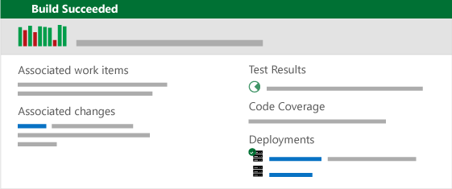
Git or TFVC
Stay connected from idea to release
Track and manage all your great ideas on kanban or scrum boards with agile tools. Collaborate as they turn into code with unlimited Git or TFVC repos. And delight your customers with every deployment using hosted builds and automated release pipelines.

Slide 9
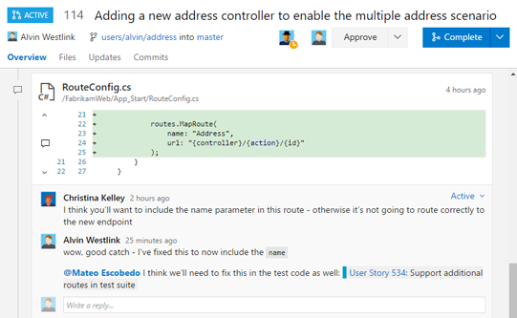
Code review, testing...
Improve code quality and catch issues early
Get social with powerful code reviews. Test and build each commit before you merge your code. Raise the quality bar every time you ship with manual, unit, exploratory, performance and load testing.

Slide 10
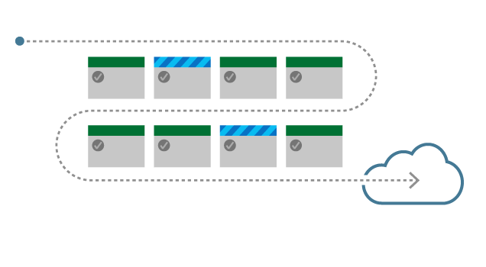
Automation
Automate and simplify your Azure deployments
Use built-in tasks and templates to set up CI and CD to an Azure web app, VM, container, Xamarin Test Cloud, HockeyApp and more. Building apps for the cloud and mobile devices has never been easier.

Slide 11
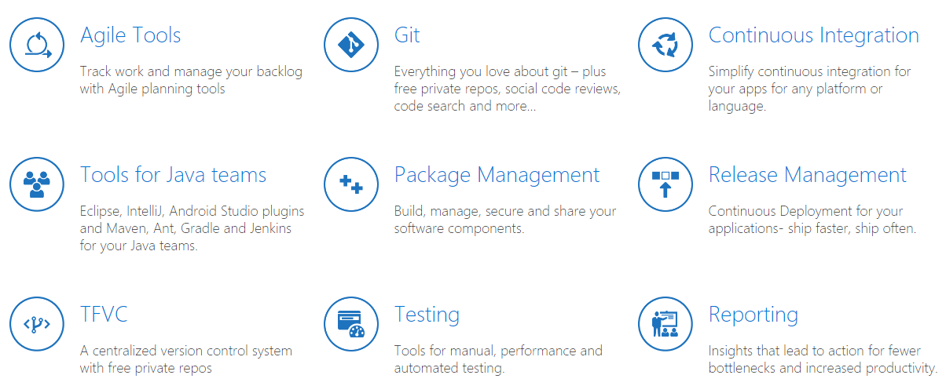

Slide 12
2. Release pipeline

Slide 13
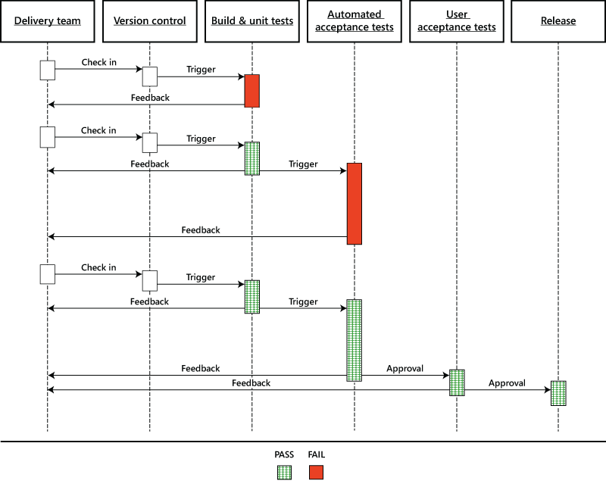
The release pipline

Slide 14
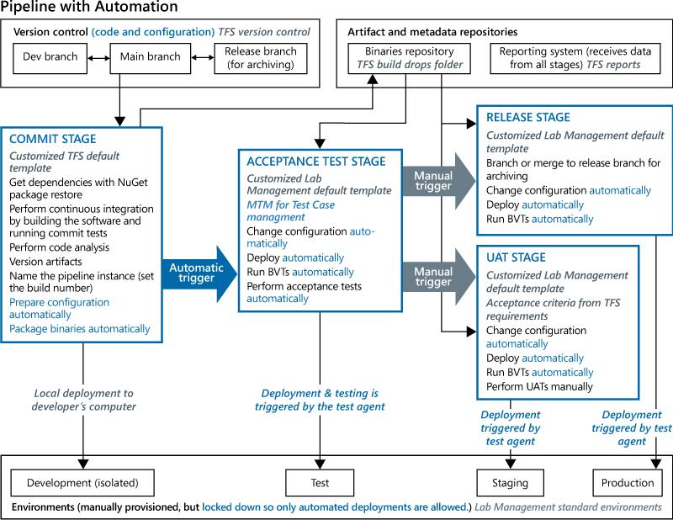
Pipeline with automation

Slide 15
Build Agent
To build your code or deploy your software you need at least one agent. As you add more code and people, you'll eventually need more.
When your build or deployment runs, the system begins one or more jobs. An agent is installable software that runs one build or deployment job at a time.

Slide 16
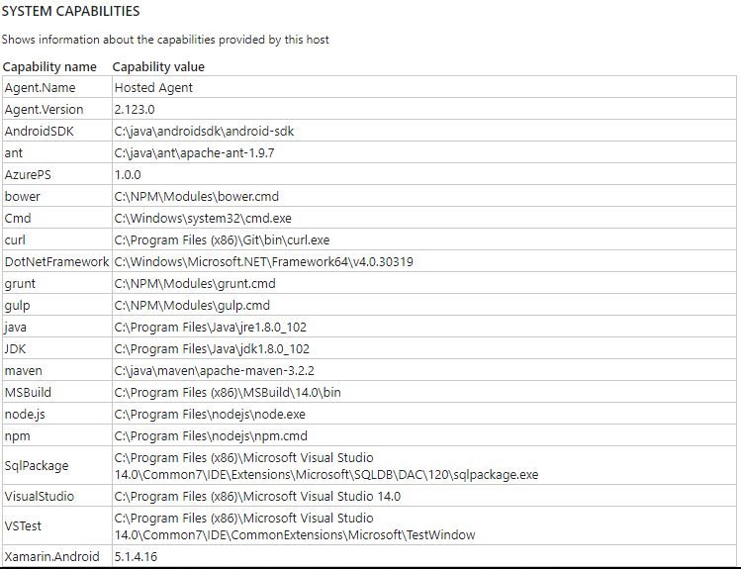

Slide 17
3. Demo

Slide 18
Infrastruktra
Okruženja
Azure SQL Database QA, STG, PROD
Azure Web service, 1 App Server, 3 App Service QA, STG, PROD
1 vm, 1 sql server
Application Insigths na STG
SonarQube public portal
Slack, MS-Teams...

Slide 19
Nešto za čitati
https://www.visualstudio.com/team-services/
https://www.visualstudio.com/learn/what-is-devops/
Continuous Delivery with Visual Studio ALM 2015 – Mathias Olausson, Jakob Ehn
Devops for web development – Mitesh Soni – Packt publishing
Building Cloud Apps with Microsoft Azure – Scott Guthrie, Mark Simms, Tom Dykstra, Rick Anderson, Mike Wasson
Testing for Continuous Delivery with Visual Studio 2012- Lary Brader, Howie Hilliker, Alan Cameron Wills
DevOps Skills for Developers with Visual Studio & TFS 2015 - by Benjamin Day

Slide 20
QA - Session
Pitanja i odgovori

Slide 21
Hvala na pažnji!

